Slide 1

Dr. Anil K Ahlawat
Professor, KIET Group of Institutions

Slide 2

Training Classification problem
Rote learning
Concept learning
Inductive learning
Concept learning as a search
General-to-specific ordering of hypothesis
Find S
The list-then-eliminate algorithm

Slide 3

Many learning problems involve classifying inputs into a discrete set of possible categories.
Learning is only possible if there is a relationship between the data and the classifications.
Training involves providing the system with data which has been manually classified.
Learning systems use the training data to learn to classify unseen data.

Slide 4

A very simple learning method.
Simply involves memorizing the classifications of the training data.
Can only classify previously seen data – unseen data cannot be classified by a rote learner.

Slide 5

Much of learning involves acquiring general concepts from specific training examples
People learn general concepts or categories such as "bird", "car", "situations in which I should study more in order to pass the exam"
birds – function defined over all animals, whose value is true for birds and false for other animals
Concept learning: Inferring a boolean-valued function from training examples of its input and output

Slide 6
Concept learning involves determining a mapping from a set of input variables to a Boolean value.
Such methods are known as inductive learning methods.
If a function can be found which maps training data to correct classifications, then it will also work well for unseen data – hopefully!
This process is known as generalization.

Slide 7

Example:
  Consider the example task of learning the target concept "days on which my friend Aldo enjoys his favorite water sport“
Example days represented by set of attributes
The attribute EnjoySport indicate whether or not Aldo enjoys his favorite water sport on this day
Task – learn to predict the value of EnjoySport for an arbitrary day, based on the values of its other attribute

Slide 8

Learn the "days on which my friend Aldo enjoys his favorite water sport“
What hypothesis representation shall we provide to the learner in this case?
Example | Sky | AirTemp | Humidity | Wind | Water | Forecast | EnjoySport
1 | Sunny | Warm | Normal | Strong | Warm | Same | Yes
2 | Sunny | Warm | High | Strong | Warm | Same | Yes
3 | Rainy | Cold | High | Strong | Warm | Change | No
4 | Sunny | Warm | High | Strong | Cool | Change | Yes

Slide 9

A hypothesis is a vector of constraints for each attribute, the hypothesis will be either
  indicate by a "?" that any value is acceptable for this attribute
  specify a single required value for the attribute
  indication by a "Ø" that no value is acceptable
If some instance x satisfies all the constraints of hypothesis h, then h classifies x as a positive example (h(x) = 1)
Example hypothesis for EnjoySport:

Slide 10
Hypothesis:
  To illustrate the hypothesis that Aldo enjoys his favorite sport only on cold days with high humidity (independent of the values of the other attributes) is represented as
  <?, Cold, High, ?, ?, ?>
The most general hypothesis - that every day is a positive example – is represented by
<?, ?, ?, ?, ?, ?>
And the most specific possible hypothesis - that no day is a positive example – is represented by
< Ø, Ø, Ø, Ø, Ø, Ø >

Slide 11
The EnjoySport concept learning task requires learning the set of days for which EnjoySport = yes, describing this set by a conjunction of constraints over the instance attributes

Slide 12

Given
  Instances X: Possible days, each described by the 6 attributes
    Sky (with possible values Sunny, Cloudy, and Rainy)
    AirTemp (with values Warm and Cold)
    Humidity (with values Normal and High)
    Wind (with values Strong and Weak)
    Water (with values Warm and Cool), and
    Forecast (with values Same and Change)

Slide 13

  Hypothesis H: Each hypothesis is described by a conjunction of constraints on the attributes. The constraints may be "?", "Ø", or a specific value
  Target concept c: EnjoySport : X → {0,1}
  Training Examples D: Positive or negative examples of the target function
Determine
  A hypothesis h in H such that h(x) = c(x) for all x in X

Slide 14
The set of items over which the concept is defined is called the set of instances, denoted by X
In this example X is set of possible days and represented by 6 attributes.
The concept or function to be learned is called the target concept, denoted by c.
In general c can be defined as:
c: : X → {0,1}

Slide 15
In current example, target concept is
c(x) = 1 if EnjoySport = Yes, and
c(x) = 0 if EnjoySport = No
Each training example is an instance of x form X
c(x) = 1 positive example
c(x) = 0 is a negative example

Slide 16

Learning problem:
  Target concept: a subset of the set of instances X
  c: X → {0, 1}
  Target function:
  Sky × AirTemp × Humidity × Wind × Water × Forecast → {Yes, No}
  Hypothesis:
  Characteristics of all instances of the concept to be learned
  Constraints on instance attributes h: X → {0, 1}

Slide 17
Satisfaction:
  h(x) = 1 iff x satisfies all the constraints of h
  h(x) = 0 otherwsie
Consistency:
  h(x) = c(x) for every instance x of the training examples
Correctness:
  h(x) = c(x) for every instance x of X

Slide 18

Determine a hypothesis h identical to the target concept c over the entire set of instances X
  only information about c is its values over the training examples
Inductive learning at best guarantees that the output hypothesis fits the target concept over the training data
  Fundamental assumption of inductive learning
Inductive Learning Hypothesis: Any hypothesis found to approximate the target function well over a sufficiently large set of training examples will also approximate the target function well over other unobserved examples

Slide 19

Concept learning can be viewed as the task of searching through a large space of hypotheses implicitly defined by the hypothesis representation
The goal of this search is to find the hypothesis that best fits the training examples
By selecting a hypothesis representation, the designer of the learning algorithm implicitly defines the space of all hypothesis the program can ever represent and therefore can ever learn
Notes:
by selecting a hypothesis representation, the designer of the learning algorithm implicitly defines the space of all hypothesis the program can ever represent and therefore can ever learn
Instances: 3 * 2 * 2* 2* 2* 2 = 96
Hypothesis: 5 * 4 * 4 * 4 * 4 * 4 = 5120 (however anyone with a NULL is equivalent to all with NULL because every example is negative
4 * 3 * 3 * 3 * 3 *3 + 1 = 973
This is a very simple learning task. Most practical learning tasks involve much larger, sometimes infinite, hypothesis spaces
Different strategies for searching

Slide 20
How big is the hypothesis space?
  In EnjoySport six attributes: Sky has 3 values, and the rest have 2
  How many distinct instances?
    Instances: 3 * 2 * 2* 2* 2* 2 = 96
  How many hypothesis?
    Hypothesis: 5 * 4 * 4 * 4 * 4 * 4 = 5120
Notes:
For Hypothesis, 3 for distinct values, 1 for most general and 1 for empty (most specific) = 3+1+1 =5
Similarly, 2+1+1 = 4 for the remaining set

Slide 21
  However that every hypothesis containing one or more NULL is equivalent to all with NULL because every example is negative
Therefore the number of semantically distinct hypothesis is only (4 * 3 * 3 * 3 * 3 *3 + 1) = 973
This is a very simple learning task. Most practical learning tasks involve much larger, sometimes infinite, hypothesis spaces
Different strategies for searching

Slide 22

Many algorithms for concept learning organize the search through the hypothesis space by relying on a very useful structure that exists for any concept learning problem: a general-to-specific ordering of hypotheses.
By taking advantage of this naturally occurring structure over the hypothesis space, we can design learning algorithms that exhaustively search even infinite hypothesis spaces without explicitly enumerating every hypothesis
Notes:
Consider sets of instances that are classified positive by h1 and by h2. h2 imposes fewer constraints on the instance, it classifies more instances positive

Slide 23
To illustrate the general-to-specific ordering, consider the two hypotheses
Let h₁ = <Sunny, ?, ?, Strong, ?, ?>
  h₂ = <Sunny, ?, ?, ?, ?, ?>
Now consider the sets of instances that are classified positive by hl and by h2.
Because h2 imposes fewer constraints on the instance, it classifies more instances as positive.
In fact, any instance classified positive by hl will also be classified positive by h2.
Therefore, we say that h2 is more general than hl.
Notes:
Consider sets of instances that are classified positive by h1 and by h2. h2 imposes fewer constraints on the instance, it classifies more instances positive

Slide 24
This intuitive "more general than" relationship between hypotheses can be defined more precisely as follows.
First, for any instance x in X and hypothesis h in H, we say that x satisjies h if and only if h(x) = 1.
We now define the more₋general₋than or equal₋to relation in terms of the sets of instances that satisfy the two hypotheses:
Given hypotheses h_{j} and h_{k}, h_{j} is more₋general₋than or equal₋to h_{k} if and only if any instance that satisfies h_{k} also satisfies h_{i}.
Notes:
Consider sets of instances that are classified positive by h1 and by h2. h2 imposes fewer constraints on the instance, it classifies more instances positive

Slide 25

Instances X
Hypotheses H
Specific
h₁
h₃
x₁
h₂
x₂
General
x₁ = <Sunny, Warm, High, Strong, Cool, Same>
x₂ = <Sunny, Warm, High, Light, Warm, Same>
h₁ = <Sunny, ?, ?, Strong, ?, ?>
h₂ = <Sunny, ?, ?, ?, ?, ?>
h₃ = <Sunny, ?, ?, ?, Cool, ?>

Slide 26
consider the three hypotheses hl, h2, and h3 from our Enjoysport example, shown in above Figure.
How are these three hypotheses related by the >=g relation?
As noted earlier, hypothesis h2 is more general than hl because every instance that satisfies hl also satisfies h2.
Similarly, h2 is more general than h3.
Note that neither hl nor h3 is more general than the other; although the instances satisfied by these two hypotheses intersect, neither set subsumes the other.

Slide 27
Notice also that the >=g and >g, relations are defined independent of the target concept.
They depend only on which instances satisfy the two hypotheses and not on the classification of those instances according to the target concept.
Formally, the >=g relation defines a partial order over the hypothesis space H (the relation is reflexive, antisymmetric, and transitive).
Informally, when we say the structure is a partial (as opposed to total) order, we mean there may be pairs of hypotheses such as hl and h3, such that hl >=g h3 and h3 !>= hl.

Slide 28
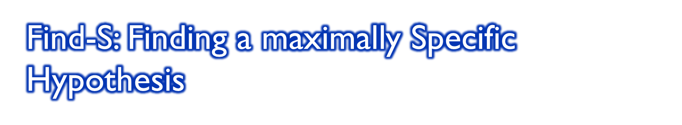
Initialize h to the most specific hypothesis in H
For each positive training instance x
  For each attribute constraint a_{i} in h
    If the constraint a_{i} is satisfied by x
    Then do nothing
    Else replace a_{i} in h by the next more general constraint that is satisfied by x
Output hypothesis h

Slide 29

How can we use the more-general-than partial ordering to organize the search for a hypothesis consistent with the observed training examples?
One way is to begin with most specific possible hypothesis in H and generalize this hypothesis each time it fails to cover an observed positive training example
A hypothesis covers a positive example if it correctly classifies the example as positive
Example | Sky | AirTemp | Humidity | Wind | Water | Forecast | EnjoySport
1 | Sunny | Warm | Normal | Strong | Warm | Same | Yes
2 | Sunny | Warm | High | Strong | Warm | Same | Yes
3 | Rainy | Cold | High | Strong | Warm | Change | No
4 | Sunny | Warm | High | Strong | Cool | Change | Yes

Slide 30
To explain the Find-S algorithm, consider the same example for EnjoySport task.
The first step of FIND-S is to initialize h to the most specific hypothesis in H
Begin: h ← <Ø, Ø, Ø, Ø, Ø, Ø>
Upon observing the first training example from Table, which happens to be a positive example, it becomes clear that our hypothesis is too specific. In particular, none of the " Ø " constraints in h are satisfied by this example, so each is replaced by the next more general constraint that fits the example; namely, the attribute values for this training example
h <- <Sunny, Warm, Normal, Strong, Warm, Same>

Slide 31
This h is still very specific; it asserts that all instances are negative except for the single positive training example we have observed.
Next, the second training example (also positive in this case) forces the algorithm to further generalize h, this time substituting a "?' in place of any attribute value in h that is not satisfied by the new example. The refined hypothesis in this case is
h <- <Sunny, Warm, ?, Strong, Warm, Same>
Upon encountering the third training example-in this case a negative example-the algorithm makes no change to h.
In fact, the FIND-S algorithm simply ignores every negative example!

Slide 32
As long as we assume that the hypothesis space H contains a hypothesis that describes the true target concept c and that the training data contains no errors, then the current hypothesis h can never require a revision in response to a negative example c must be more-general-than-or-equal-to h
To complete our trace of FIND-S, the fourth (positive) example leads to a further generalization of
h ← <Sunny, Warm, ?, Strong, ?,?>
At each step h is the most specific hypothesis consistent with the training examples observed up to this point

Slide 33
Many algorithms that utilize this more_general_than partial ordering has Find-S converged to the correct target concept?
It has no way of knowing whether it found the only hypothesis in H consistent with data
Can't deal with noise or errors in training data
Unclear whether we should prefer the most specific hypothesis
The FIND-S algorithm illustrates one way in which the more-general-than-partial ordering can be used to organize the search for an acceptable hypothesis.
The search moves from hypothesis to hypothesis, searching from the most specific to progressively more general hypotheses along one chain of the partial ordering.

Slide 34
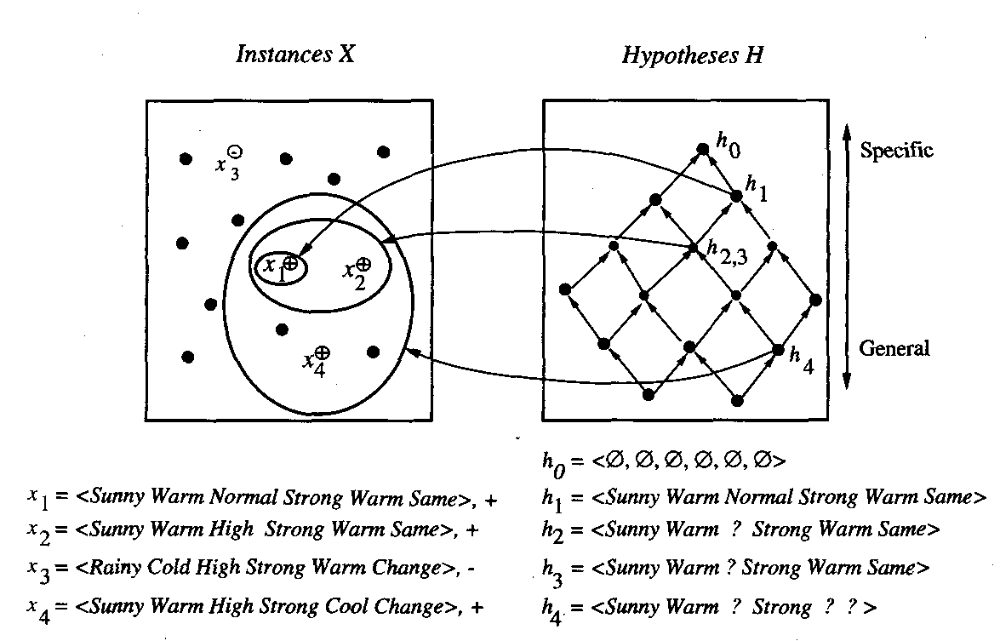

Slide 35
Figure illustrates this search in terms of the instance and hypothesis spaces and the hypothesis space search performed by FIND-S
At each step, the hypothesis is generalized only as far as necessary to cover the new positive example.
The search begins (ho) with the most specific hypothesis in H, then considers increasingly general hypotheses (hl through h4) as mandated by the training examples.
In the instance space diagram, positive training examples are denoted by "+,“ and negative by "-," and instances that have not been presented as training examples are denoted by a solid circle.

Slide 36
Therefore, at each stage the hypothesis is the most specific hypothesis consistent with the training examples observed up to this point (hence the name FIND-S)
FIND-S is guaranteed to output the most specific hypothesis within H that is consistent with the positive training examples.
Its final hypothesis will also be consistent with the negative examples provided the correct target concept is contained in H, and provided the training examples are correct.
However, there are several questions still left unanswered by this learning algorithm, such as:

Slide 37
Has the learner converged to the correct target concept?
Although FIND-S will find a hypothesis consistent with the training data, it has no way to determine whether it has found the only hypothesis in H consistent with the data (i.e., the correct target concept), or whether there are many other consistent hypotheses as well.
We would prefer a learning algorithm that could determine whether it had converged and, if not, at least characterize its uncertainty regarding the true identity of the target concept.

Slide 38
Why prefer the most specific hypothesis?
In case there are multiple hypotheses consistent with the training examples, FIND-S will find the most specific.
It is unclear whether we should prefer this hypothesis over, say, the most general, or some other hypothesis of intermediate generality.
Are the training examples consistent?
In most practical learning problems there is some chance that the training examples will contain at least some errors or noise.
Such inconsistent sets of training examples can severely mislead FIND-S, given the fact that it ignores negative examples.
We would prefer an algorithm that could at least detect when the training data is inconsistent and, preferably, accommodate such errors.

Slide 39
What if there are several maximally specific consistent hypotheses?
In the hypothesis language H for the EnjoySport task, there is always a unique, most specific hypothesis consistent with any set of positive examples.
However, for other hypothesis spaces there can be several maximally specific hypotheses consistent with the data.
In this case, FIND-S must be extended to allow it to backtrack on its choices of how to generalize the hypothesis, to accommodate the possibility that the target concept lies along a different branch of the partial ordering than the branch it has selected.
Furthermore, we can define hypothesis spaces for which there is no maximally specific consistent hypothesis, although this is more of a theoretical issue than a practical one

